Slide 1
Unit 1: An Introduction to Law
Part 1: Law – It’s Purpose and History
1.2 – Early and Modern Legal History

Slide 2
In the beginning...
...societies made laws…
BUT
societies change…
...so…
LAWS CONSTANTLY CHANGE/EVOLVE

Slide 3
Timeline of Early Legal History
1700s BCE -- Code of Hammurabi (Babylon)
1300s BCE -- Biblical/Mosaic law (Hebrew people)
450 BCE -- Twelve Tables (Roman)
400 BCE -- jury system introduced (Greece)
100 CE -- Roman law spreads throughout Europe...law becomes a profession
527 CE -- Justinian’s Code (Roman)

Slide 4
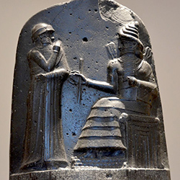
Code of Hammurabi
one of earliest sets of recorded laws
written by Hammurabi, King of Babylon (1792-1750 BCE) in modern-day Iraq
contains over 300 simple laws
laws reflect patriarchal (male-dominated) society
hierarchy of power: gods - King - male nobles - wives and children of nobles - poor – slaves

Slide 5
Code of Hammurabi (continued)
codification of country’s laws under headings like “family”, “criminal”, “civil”
penalties quite harsh - Example: death penalty for robbery, “an eye for an eye”, hand cut off for striking a parent
emphasized retribution instead of restitution

Slide 6
retribution
...criminal sentence focused on punishment
restitution
...criminal sentence focused on restoring, or paying back the victim

Slide 7
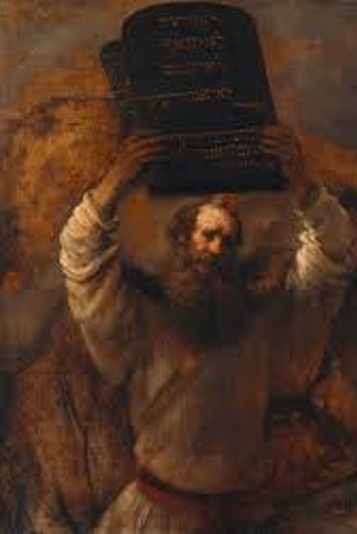
Mosaic Law
law given to the Hebrew people (1300s BCE)
found in the first 5 books of the Old Testament part of the Bible
summary of this law is in the Ten Commandments

Slide 8
Mosaic Law (continued)
differences b/w Mosaic Law & Hammurabi’s Code:
Mosaic leaned more towards restitution (paying fines instead of being killed for a crime)
Mosaic more concerned with punishing deliberate acts, instead of accidents
Mosaic had less concern for status and wealth...more value given to poor people

Slide 9
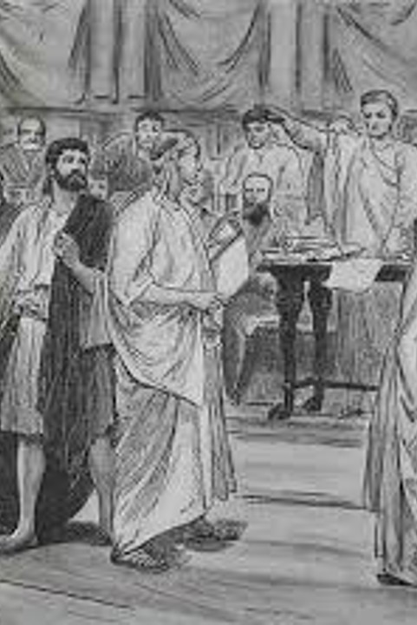
Greek Law
Some city-states in Ancient Greece (like Athens) were democracies but only a small number of “citizens” had political rights. Women, children, slaves and outsiders were excluded
400 BCE All citizens (wealthy men) expected to vote and do jury duty. Juries ranged from 101, 505, or 1001 citizens.

Slide 10
jury
...a group of people that hears a legal case, and determines guilt/innocence, and sometimes sentences

Slide 11
Greek Law (continued)
If a woman was on trial, she could not speak for herself (citizens had to speak for her).
If found guilty, both the accused and the accuser suggested a sentence and the jury voted on it.

Slide 12
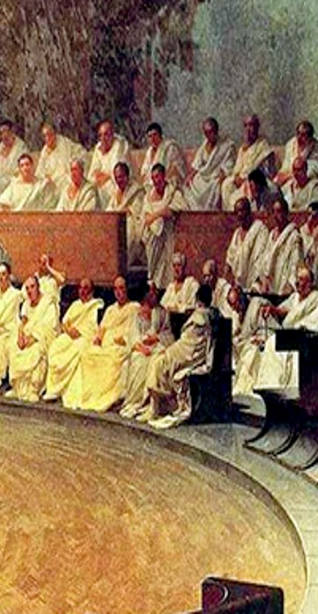
Roman Law
Twelve Tables – one of the first legal codes in Roman Law
Roman law became basis for law for Western Europe
Emphasis on equity > law should be fair and just & all people are equal under the law

Slide 13
Roman Law
Roman law founded on key principles:
the law must be recorded
justice shouldn’t be left to judges alone to interpret
lawyers evolved from Roman legal practice

Slide 14
lawyer
...expert in the practice of law...developed from the Roman legal experience

Slide 15
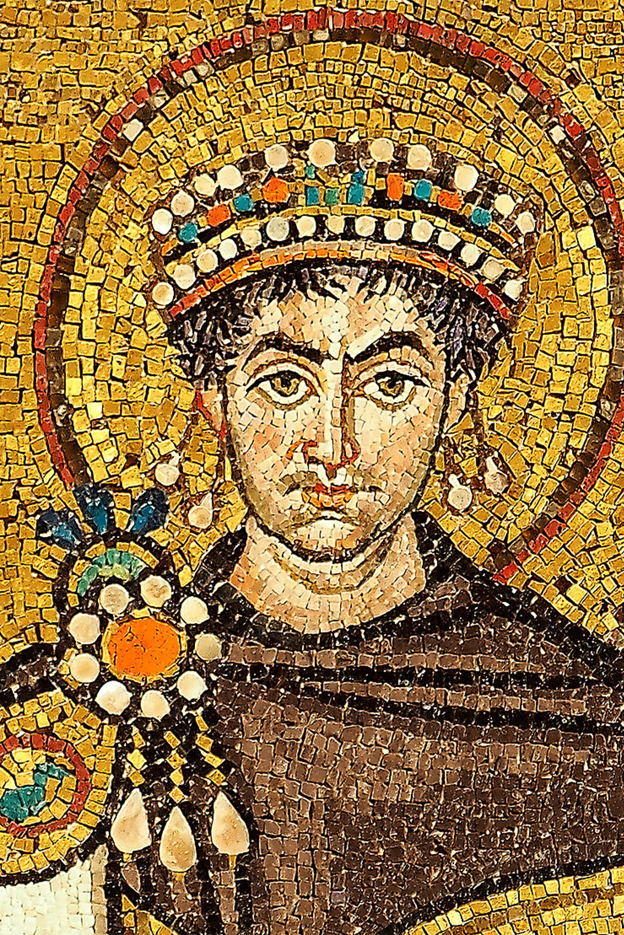
Justinian’s Code
Roman Empire split into Eastern & Western parts in 395CE. Justinian was emperor of Eastern or Byzantine empire from 527-565 CE
He had 1000 years of Roman laws codified as the Justinian Code, a collection of past Roman laws, opinions from legal experts, and new laws he enacted.
The Justinian Code emphasized equality under the law.
Notes:
the word “justice” is derived from his name.

Slide 16
Key Contributors to Modern Law in Canada
3 key contributors:
British law
French law
Indigenous law

Slide 17
Timeline of Modern Legal History
1066 CE -- feudal law established in England by William the Conqueror
1100s CE -- Henry II of England reforms law and establishes the jury system
1215 CE -- King John of England signs Magna Carta...established Rule of Law
1450 CE -- Great Binding Law established by Iroquois Confederacy
1804 CE -- Napoleonic Code goes into effect in France

Slide 18
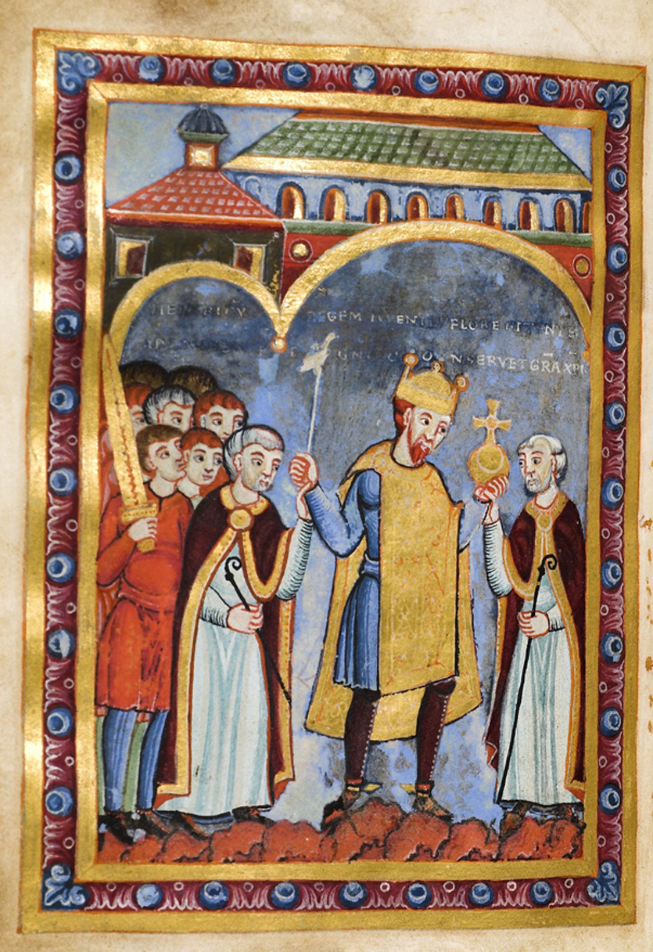
Early British Law
after Romans left England (around 410 CE), Britons turned to God to determine guilt/innocence
believed that God would naturally punish guilty people...innocent people wouldn’t be harmed

Slide 19
Early British Law (cont.)
believed that God would reveal guilt/innocence through a test of ‘chance’
trial by combat
trial by oath-helping
trial by ordeal

Slide 20
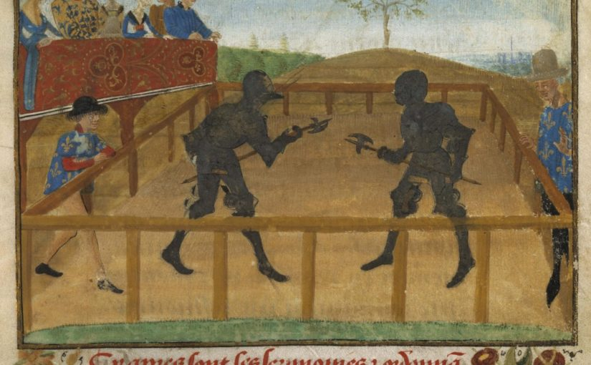
trial by combat ...determining guilt or innocence by fighting a duel...survivor is innocent

Slide 22
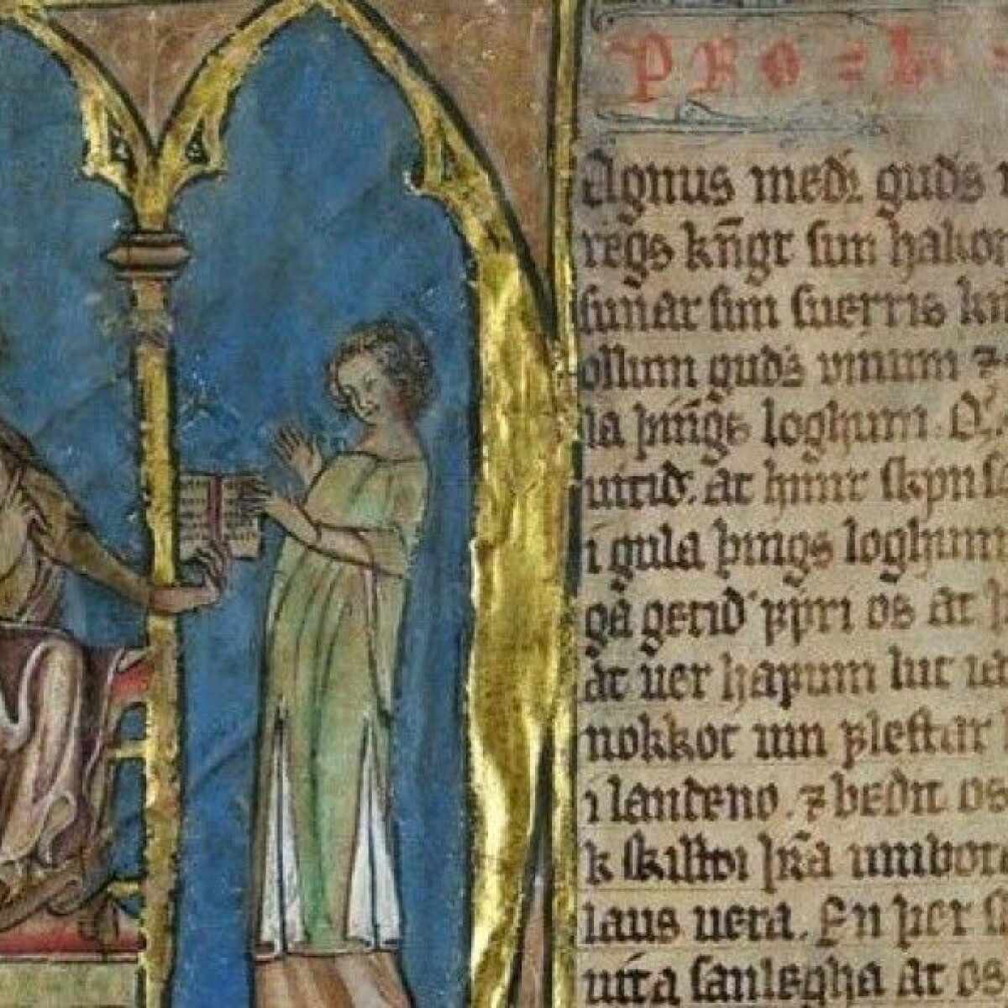
trial by oath-helping ...determining guilt or innocence by having people swear an oath before God that the accused was innocent

Slide 23
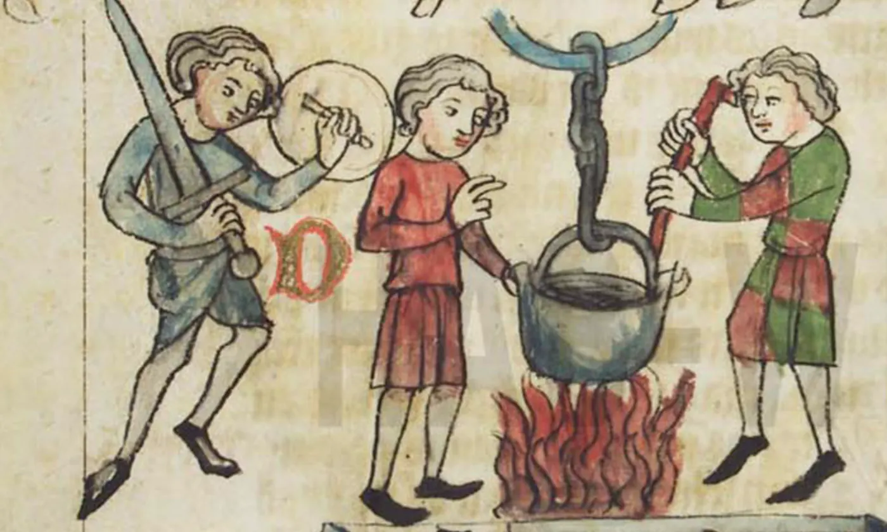
trial by ordeal ...determining guilt or innocence by torturing accused person...if they survived, they were considered innocent...if they died, they were considered guilty
Notes:
Judicial ordeals took several forms, from dunking the defendant in a pool of holy water to walking him barefoot across burning plowshares. Among the most popular, however, was the ordeal of boiling water and the ordeal of burning iron. In the former, the defendant plunged his hand into a cauldron of boiling water and fished out a ring. In the latter, he carried a piece of burning iron several paces. A few days later, the defendant’s hand was inspected: if it was burned, he was guilty; if not, he was innocent.
Judicial ordeals were administrated and adjudged by priests, in churches, as part of special masses. During such a mass, the priest requested God to reveal to the court the defendant’s guilt or innocence through the ordeal – letting boiling water or burning iron burn the defendant if he were guilty, performing a miracle that prevented the defendant’s hand from being burned if he were innocent. The idea that God would respond to a priest’s request in this way reflected a popular medieval belief according to which ordeals were iudiciua Dei – ‘judgments of God’.

Slide 25
Opposing Sides
legal system is based on two parties arguing their opposing points
the three previous tests of chance (trial by ordeal, trial by combat, trial by oath-helping) helped to establish adversarial system
2 opposing sides + 1 judge

Slide 26
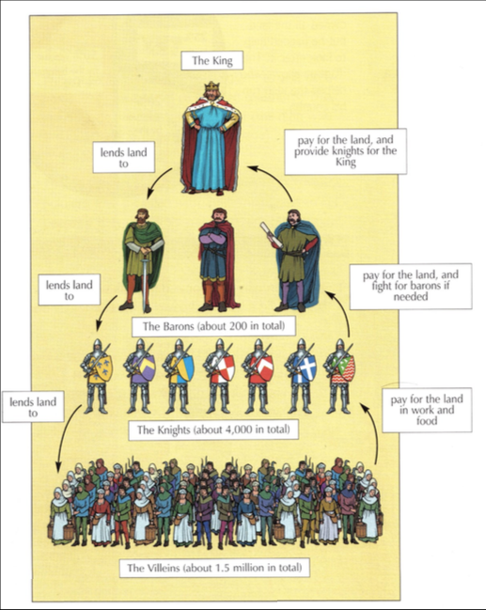
Feudal Law
William the Conqueror, Duke of Normandy (France) invaded England in 1066, and made himself King
Established a feudal system of law and government
Feudalism…
King divides country into parcels - appoints a nobleman to be in charge of each parcel - nobleman become King’s vassals (servants), and fight for the King if necessary
noblemen then allowed peasants to live on their land and farm it - in exchange, the peasants acted as vassals to the noblemen - even acting as an army for the noblemen

Slide 27
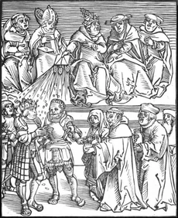
Noblemen as Judges
in feudal law, noblemen acted as judges for disputes that occurred in their territory
this system was flawed...some noblemen were just and fair...others were cruel and unfair
for many years, citizens accepted this system because they believed King had divine right to be King

Slide 28
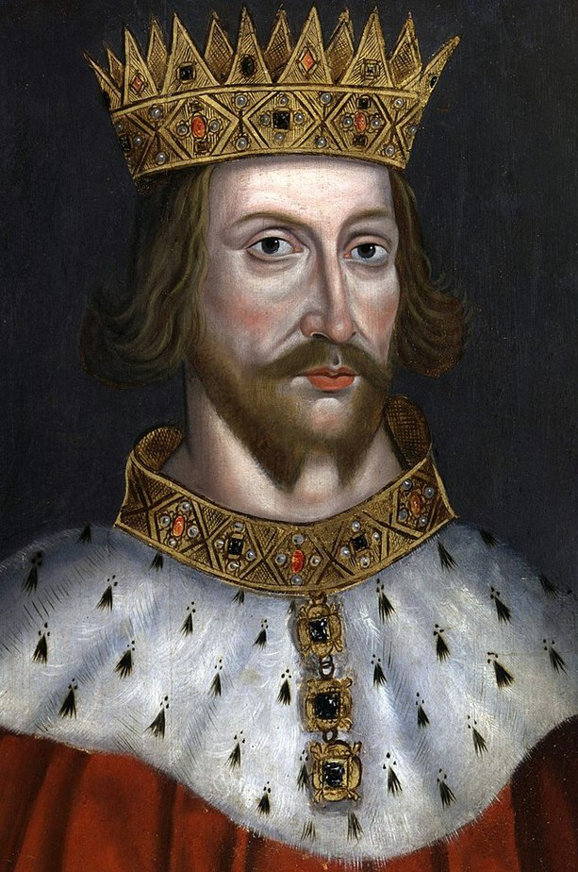
British People Protest
eventually, British citizens had enough of the injustices from noblemen judges...they started to protest
King Henry II acted on these protests
appointed judges to travel around hearing cases all over England ( instead of the noblemen)
these judges met in London occasionally to discuss and record cases - making their future decisions more consistent

Slide 29
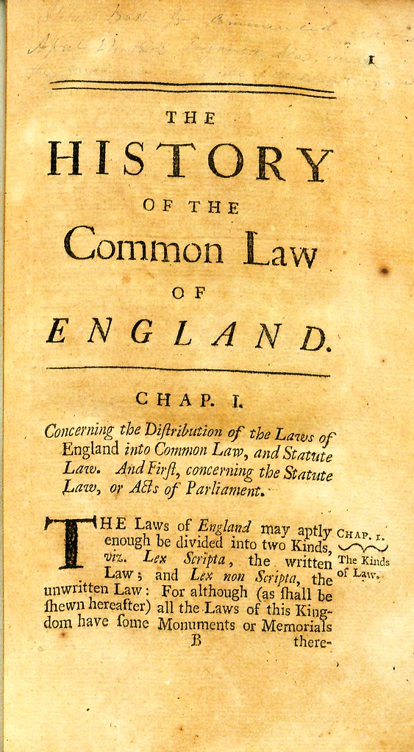
Common Law
as more legal decisions in England were recorded and discussed among judges...a system of common law emerged
a common law system is based on precedent and case law
common law, precedent, and case law are VITAL components of our current legal system

Slide 30
case law ...recording case details and decisions to use as precedents for future cases

Slide 31
common law ...system where legal decisions are based on similar cases that have been decided in the past

Slide 32
precedent ...legal decision that sets the standard for similar cases in the future

Slide 33
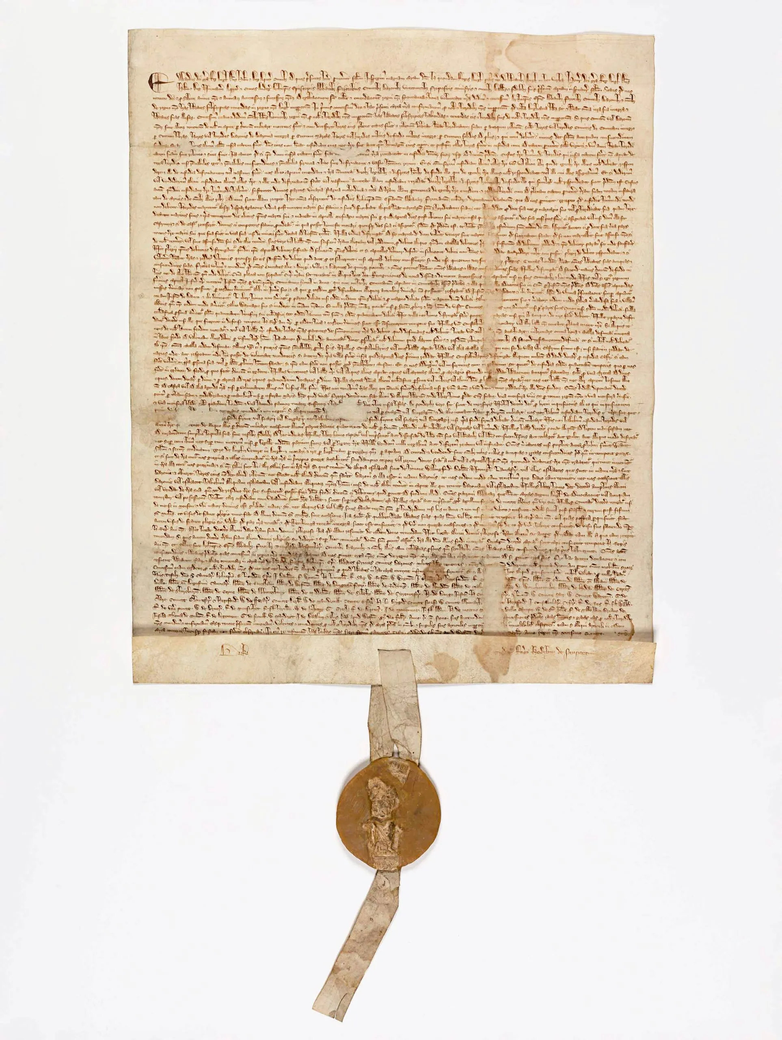
Rule of Law & Magna Carta
Judges helped to improve the legal system but…
King John (1199-1216) still “above the law”
the noblemen forced King John to sign the Magna Carta (1215 CE)
this formed basis of rule of law = everyone, even rulers, must obey the law and equality, and people’s legal rights could not be changed without their consent.
Also granted habeas corpus

Slide 34
Magna Carta ...charter document that guaranteed basic rights; including right to justice, and the right to a fair trial

Slide 35
rule of law ...all people and organizations are accountable to the law, and the law is fairly structured and enforced

Slide 36
habeas corpus ...right of arrested person to be promptly brought before judge, instead of being detained without cause

Slide 37
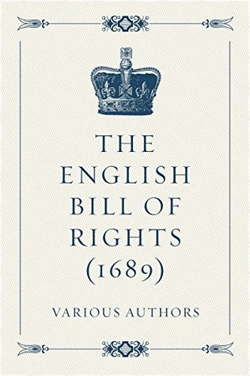
Parliament & Statute Law
in England around 1265, King Henry III forced to create the first Parliament.
Parliament helped make laws (or statutes) for the country
- 1689, Parliament passed the English Bill of Rights.
→ free speech, free elections, freedom of assembly, etc
→ gave parliament power over the monarchy

Slide 38
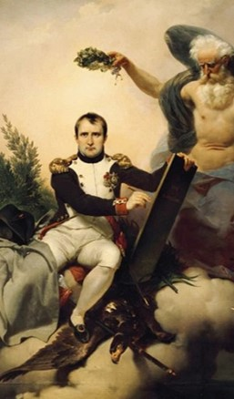
Napoleonic Code - 1804
Napoleon Bonaparte led writing of Napoleonic Code after the French Revolution (1789)
formed the basis of French civil law
legal standard in the Code was clear, easy to understand, and unbiased
applied to property rights, wills, contracts, family law
Quebec civil law is based on Napoleonic Code

Slide 39
The Great Binding Law
- Indigenous communities across North America had established governments, religions, social structures, and legal systems prior to British and European settlement.
- laws and customs passed down through generations by oral tradition

Slide 40
The Great Binding Law
around 1450, five groups formed the Haudenosaunee Confederacy
a sixth group joined (becoming known as the Six
Nations)
recorded the Great Binding Law (or Gayanashagowa)
outlined rights, responsibilities, and duties and
included laws.

